Slide 1


大模型系列 – 大模型算法
Transformer 介绍
ZOMI

Slide 2
大模型业务全流程
数据 & 模型算法
模型训练 & 微调
模型验证 & 推理部署
2. 数据处理
4. 模型训练
6. 模型微调
7. 模型验证
开源
数据
数据
预处理
向量
数据库
混合精度
梯度检查
梯度累积
…
全参微调
下游
任务
测评
标准
bench
mark
3. 模型算法
5. 分布式并行
低参微调
8. 推理与智能体
LLM模型
架构
多模态
一切皆Tokens
训练集群稳定性
指令微调
量化
压缩
推理
加速
9. Agent
智能体
1. AI 集群建设
计算、存储、网络
AI 集群机房建设
AI 集群上线与运维
集群算力准备

Slide 3
关于本内容
大模型都是什么模型结构？
为什么出现 Transformer？
Transformer 结构介绍？
Bert vs GPT 大模型出现

Slide 4
1. LLM

Slide 5
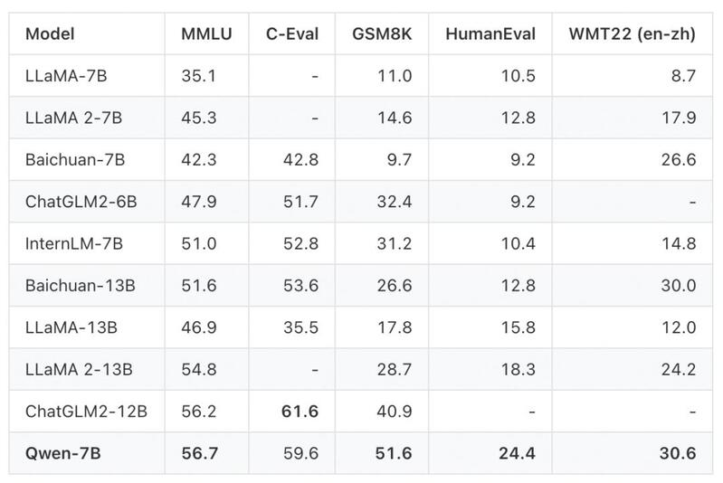
大模型涌现
GPT3
LLAMA1
LLAMA2
Baichuan1
Baichuan2
Qwen
ChatGLM
Mistral MOE

Slide 6
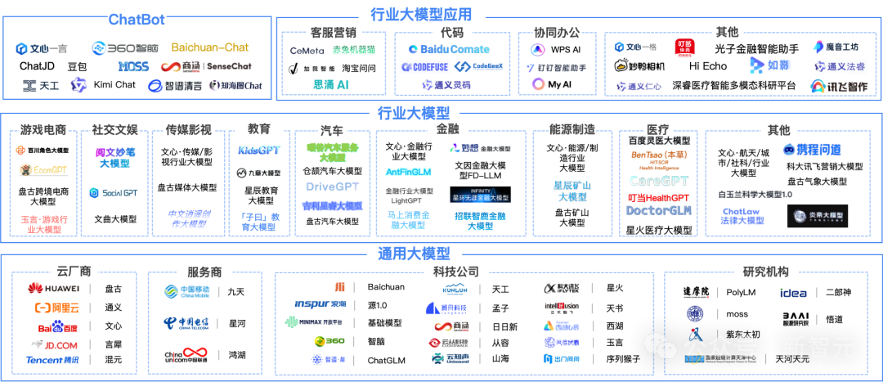
大模型涌现

Slide 7


Slide 8
目前看到所有的大模型都基于Transformer 架构

Slide 9
2. Motivation for Transformers

Slide 10
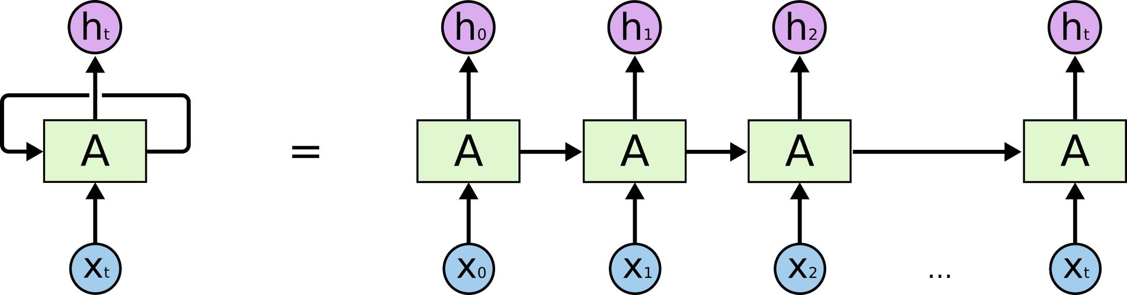
Problems with RNNs = Motivation for Transformers
RNN循环神经网络是一个按时间序列的前馈神经网络模型，经过训练后可以处理顺序数据输入并将其转换为特定的顺序数据输出。

Slide 11
RNN has three major disadvantages
Slow to Train
训练慢
Slow to Train
训练慢
Vanishing Gradient
梯度消失/梯度爆炸
Slow to Train
训练慢
Short Memory
短期记忆
Vanishing Gradient
梯度消失/梯度爆炸

Slide 12

LSTM
long short-term memory，LSTM 是一种特殊 RNN，主要是为了解决长序列训练过程中的梯度消失和梯度爆炸问题。
Forget Gate
Input Gate
Output Gate

Slide 13
LSTM has three major disadvantages
Slow to Train
训练慢
Slower to Train
训练更慢
Slow to Train
训练慢
Vanishing Gradient
梯度消失/梯度爆炸
Short Memory
短期记忆
Vanishing Gradient
梯度消失/梯度爆炸

Slide 14
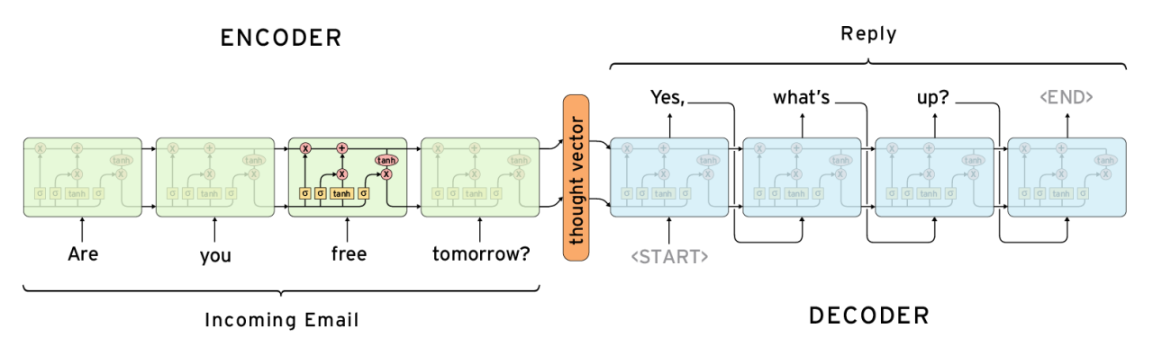
Encoder-Decoder Structure
Seq2Seq（Sequence-to-Sequence，序列到序列）是一类特殊序列建模问题；
Encoder-Decoder 模型包括编码器和解码器，编码器（Encoder）先对输入的序列进行处理，将处理后向量发送给解码器（Decoder），转化成想要的输出。

Slide 15
3. Transformer and Attention

Slide 16
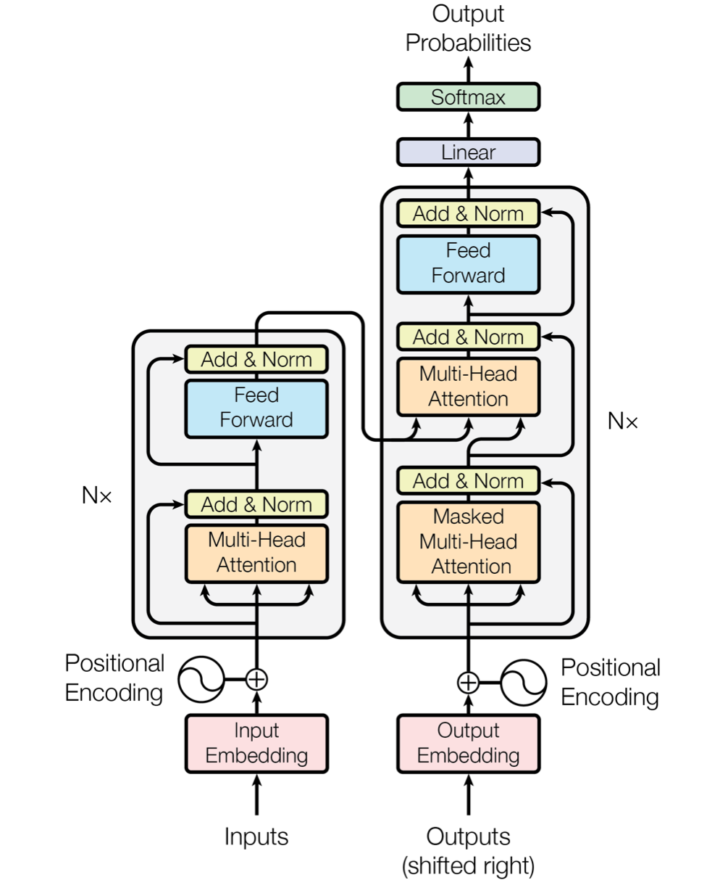
“Original” Transformer (Vaswani et al., 2017).
The architecture is tested on English-to-German and English-to-French translation using the standard WMT2014 datasets.
English-to-German: 4.5M sentence pairs, 37k tokens vocabulary.
English-to-French: 36M sentence pairs, 32k tokens vocabulary.
8 P100 GPUs (150 TFlops FP16), 0.5 day for the small model, 3.5 days for the large one.

Slide 17
“Original” Transformer (Vaswani et al., 2017).
Tokenization
Input Embeddings
Position Encodings
Residuals
Query
Key
Value
Add & Norm
Encoder
Decoder
Attention
Self Attention
Multi Head Attention
Masked Attention
Encoder Decoder Attention
Output Probabilities / Logits
Softmax
Decoder only models

Slide 18

“Original” Transformer (Vaswani et al., 2017).
Tokenization
Input Embeddings
Position Encodings
Residuals
Query
Key
Value
Add & Norm
Encoder
Decoder
Attention
Self Attention
Multi Head Attention
Masked Attention
Encoder Decoder Attention
Output Probabilities / Logits
Softmax
Decoder only models

Slide 19
任务：机器翻译 Machine Translation
Slow to Train
训练慢
Targets
Ich have eine Frau
Slow to Train
训练慢
Input
I ate an woman

Slide 20
Transformer：Inputs
Processing Inputs
Slow to Train
训练慢
Input
I ate an woman

Slide 21
Transformer：Inputs

Slide 22
Transformer：Inputs

Slide 23
Transformer：Encoder
where is the content？

Slide 24
Transformer：Encoder

Slide 25
Transformer：Encoder

Slide 26
Transformer：Encoder

Slide 27
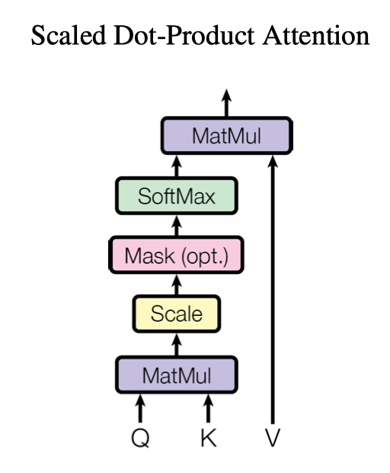
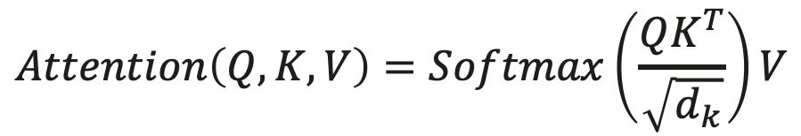
Attention and Multi-Head Attention
对当前 Query 和所有的 Key 计算相似度，将这个相似度值通过 Softmax 进行得到一组权重，根据这组权重与对应 Value 乘积求和得到 Attention 下 Value 值。
$$Attention\left(Q,K,V\right)=Softmax\left(\frac{QK^{T}}{\sqrt{d_{k}}}\right)V$$

Slide 28
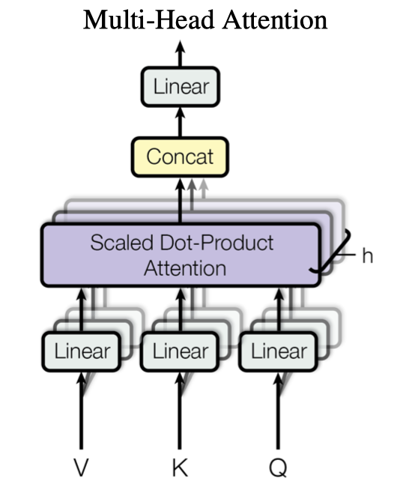
Attention and Multi-Head Attention
Multi-head Attention其实就是多个Self-Attention结构的结合，每个head学习到在不同表示空间中的特征。
$$MultiHead\left(Q,K,V\right)=Concat\left(H_{1},H_{2},⋯,H_{h}\right)W^{0}$$
$$H_{i}=Attention\left(QW_{i}^{Q},KW_{i}^{K},VW_{i}^{V}\right),i=1,⋯h$$

Slide 29
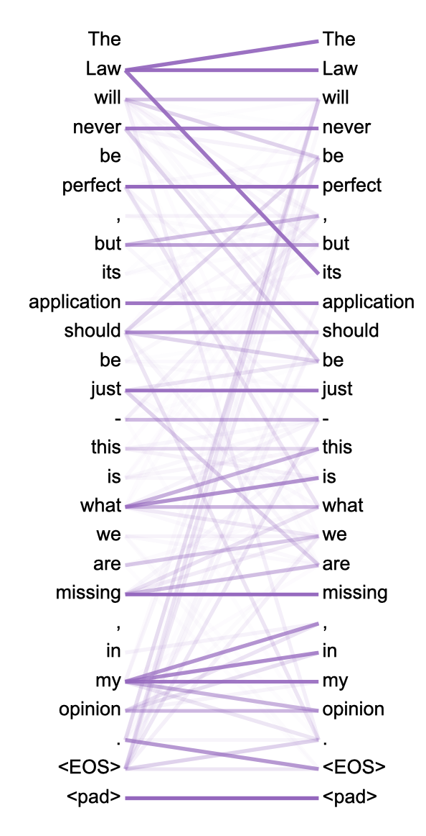
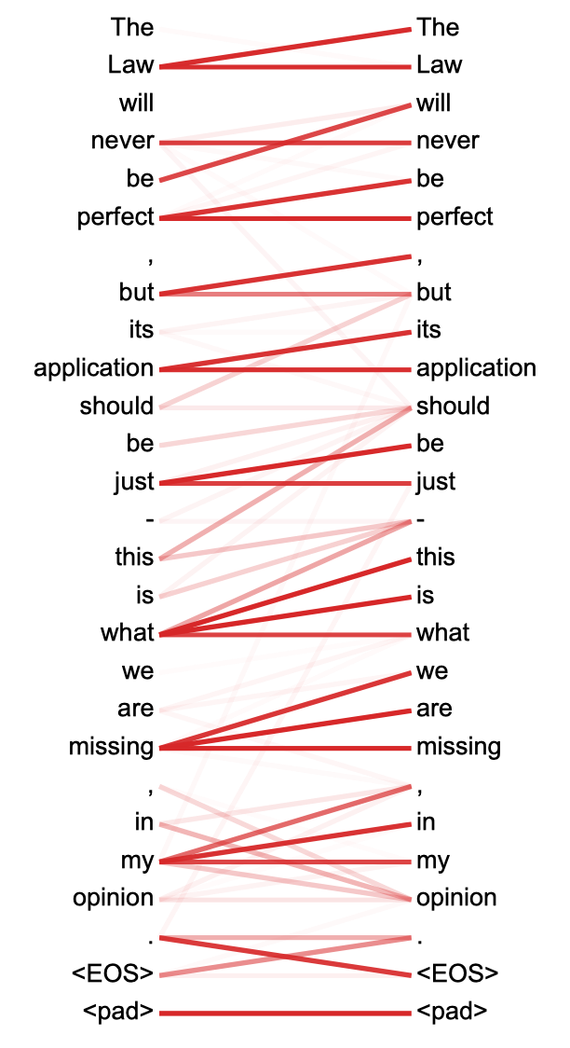
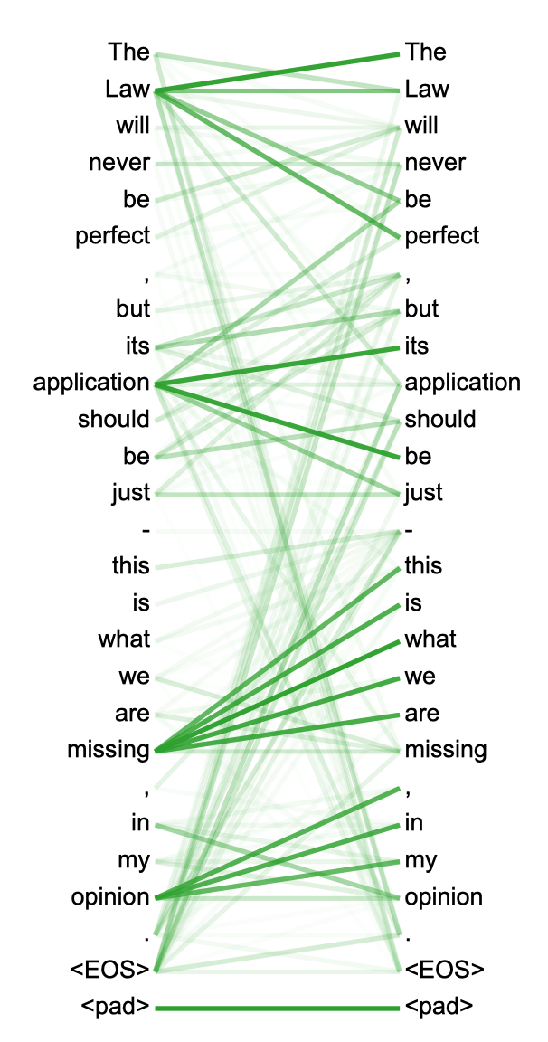
Attention 相关性可视化
两个head学习到的Attention侧重点可能略有不同，这样给了模型更大的容量。
visualization of the attention as computed by one head of the layer 5 of the encoder

Slide 30
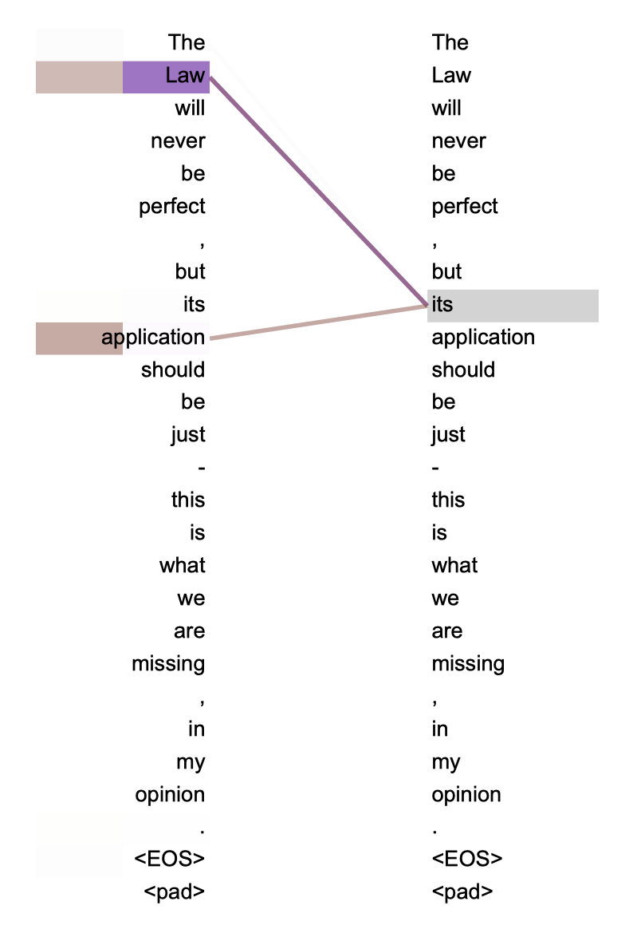
Attention 相关性可视化
left: Visualization of the attention as computed by one head of the layer 5 of the encoder
right: Attention given by the word “its” for two different heads is on “law” and “ap- plication” which provides help for gender and grammatical issues.

Slide 31
Transformer: Add & Norm
Normalization (Z)
Mean 0, Std dev 1
Stabilizes Training
Regularization Effect
Add → Residuals
Avoid vanishing gradients
Train deeper networks

Slide 32
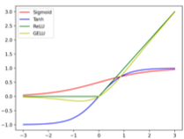
Transformer: Feed Forward
Feed Forward
Non Linearity
Complex Relationships
Learn form each other

Slide 33
Transformer: Add & Norm

Slide 34
Transformer: Encoder

Slide 35
“Original” Transformer (Vaswani et al., 2017).

Slide 36
“Original” Transformer (Vaswani et al., 2017).
Tokenization
Input Embeddings
Position Encodings
Residuals
Query
Key
Value
Add & Norm
Encoder
Decoder
Attention
Self Attention
Multi Head Attention
Masked Attention
Encoder Decoder Attention
Output Probabilities / Logits
Softmax
Decoder only models

Slide 37
任务：机器翻译 Machine Translation
Slow to Train
训练慢
Targets
Ich have eine Frau
Slow to Train
训练慢
Input
I ate an woman

Slide 38
Transformer: Target
Slow to Train
训练慢
Targets
Ich have eine Frau

Slide 39
Transformer: Target

Slide 40
Transformer: Masked Multi Head Attention
Inference

Slide 41
Transformer: Masked Multi Head Attention
Training
Outputs at time T should only pay attention to outputs until time T-1
时间T的输出应仅关注时间T-1之前的输出

Slide 42
Transformer: Masked Multi Head Attention
Training
Outputs at time T should only pay attention to outputs until time T-1
时间T的输出应仅关注时间T-1之前的输出

Slide 43
Transformer: Masked Multi Head Attention
Training
Mask the available attention values?
掩盖现有的注意力值?

Slide 44
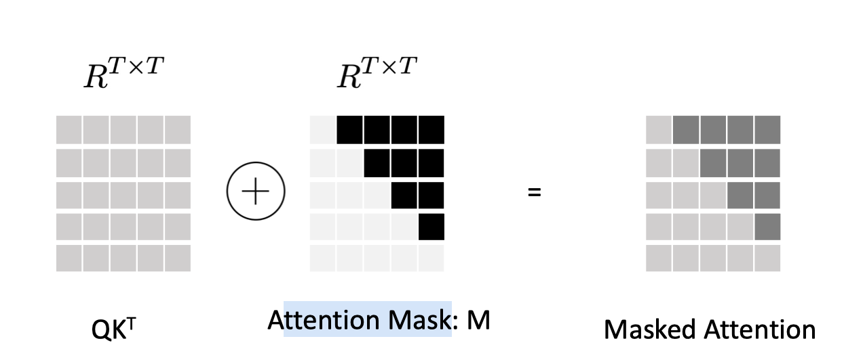
Transformer: Masked Multi Head Attention
Masked Multi Head Attention: Z’

Slide 45
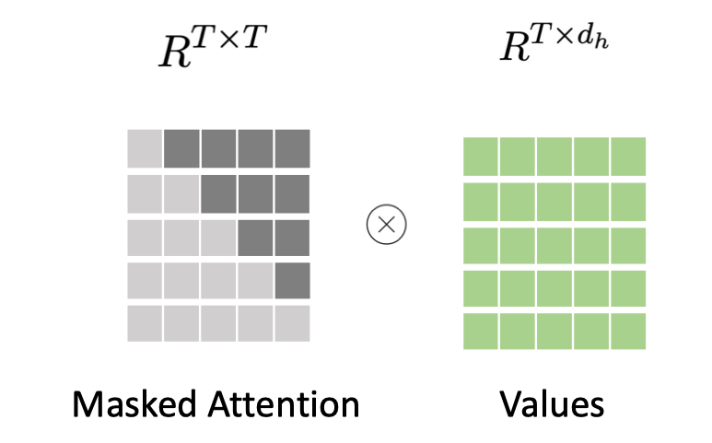
Transformer: Masked Multi Head Attention
Masked Multi Head Attention: Z’

Slide 46
Transformer: Masked Multi Head Attention

Slide 47
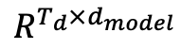
Transformer: Masked Multi Head Attention
$$R^{T_{d}×d_{model}}$$

Slide 48
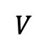
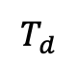
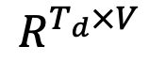
Transformer: Masked Multi Head Attention
$$V$$
$$T_{d}$$
$$R^{T_{d}×V}$$

Slide 49
“Original” Transformer (Vaswani et al., 2017).
Tokenization
Input Embeddings
Position Encodings
Residuals
Query
Key
Value
Add & Norm
Encoder
Decoder
Attention
Self Attention
Multi Head Attention
Masked Attention
Encoder Decoder Attention
Output Probabilities / Logits
Softmax
Decoder only models

Slide 50
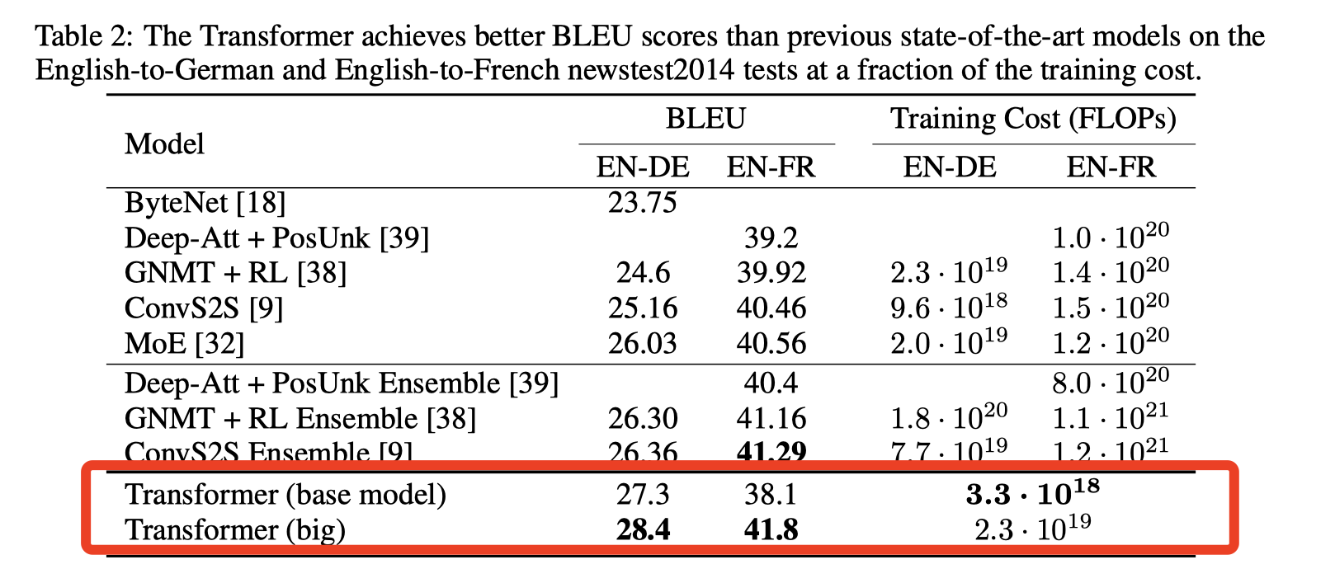
Transformer 最终效果

Slide 51
Transformer 优点
模型在处理序列输入时，可以对整个序列输入进行并行计算，突破 RNN 不能并行计算限制
相比 CNN，计算两个位置之间的关联所需的操作次数不随距离增长
Attention 机制更具可解释性，各注意头 attention head 可以学习不同的关联特征
模型的规模可以随着 Encoder 和 Decoder 的堆叠而不断增加，不需要考虑特征减少

Slide 52
4. BERT vs GPT

Slide 53
从 Transformers 到大模型
Representation
Generation

Slide 54
从 Transformers 到大模型
Input – input tokens
Output – hidden states
Model can see all timesteps
Does not usually output tokens, so no inherent auto-regress
Input – output tokens and hidden states*
Output – output tokens
Model can only see previous timesteps
Model is auto-regressive with previous timesteps’ outputs
Representation
Generation

Slide 55
2018 – The Inception of the LLM Era
BERT
Oct 2018
GPT-1
Jun 2018
Representation
Generation

Slide 56
BERT
BERT (Bidirectional Encoder Representation from Transformers, Devlin et al., 2018) is an encoder of a transformer pre-trained with:
• Masked Language Model (MLM), that consists in predicting [15% of] words which have been replaced with a “MASK” token.
• Next Sentence Prediction (NSP), which consists in predicting if a certain sentence follows the current one.
It is then fine-tuned on multiple NLP tasks.

Slide 57
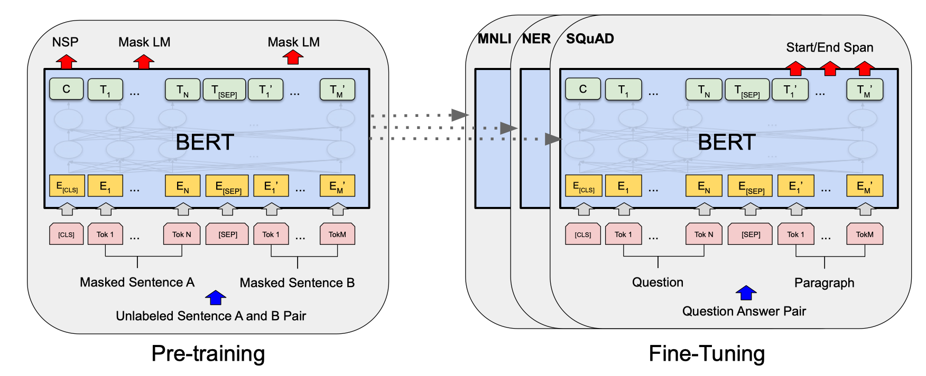
BERT： from pre-training to Fine-Tuning

Slide 58
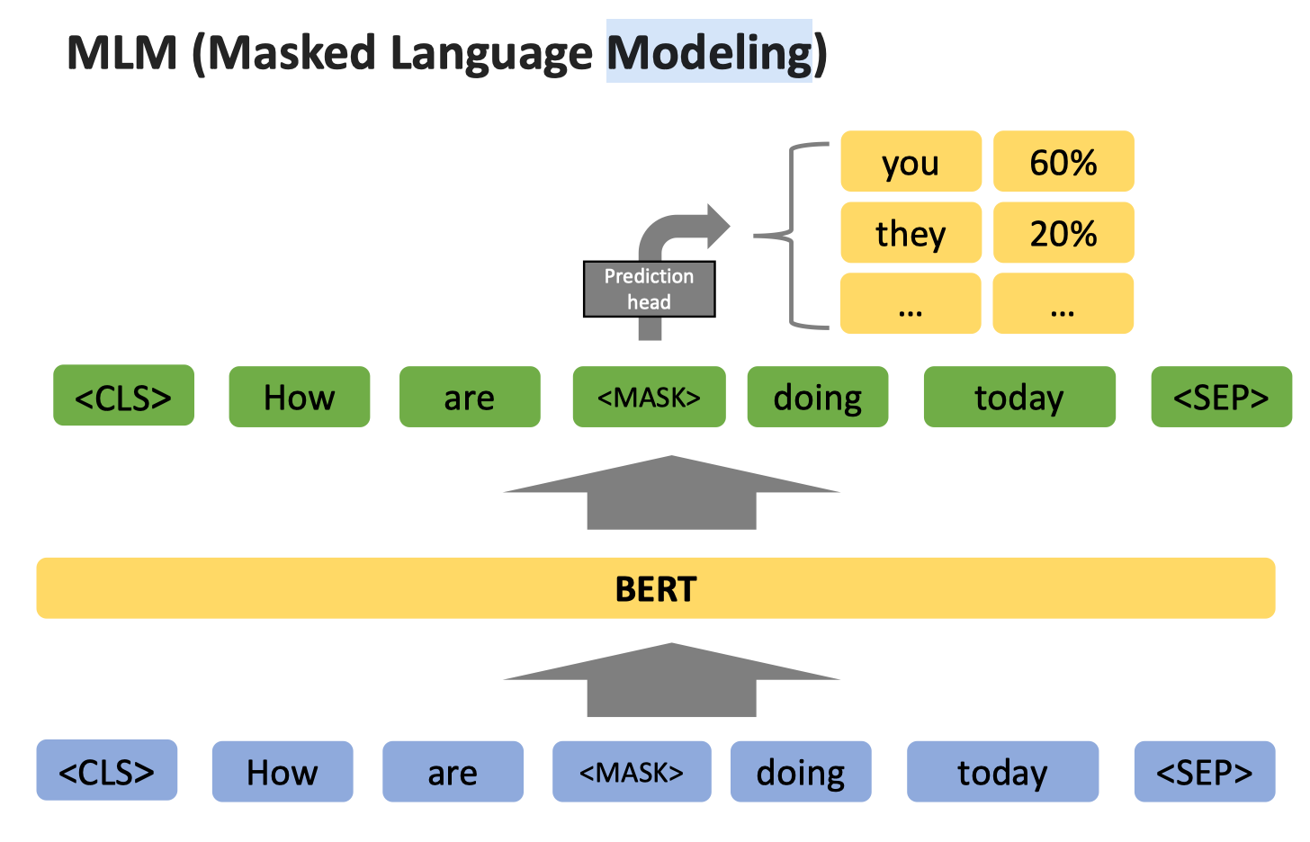
MLM, Masked Language Modeling

Slide 59
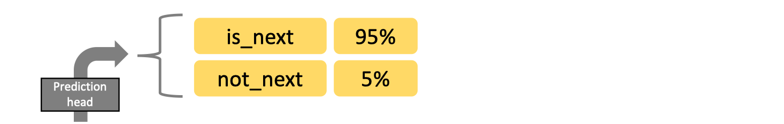
MLM, Masked Language Modeling

Slide 60
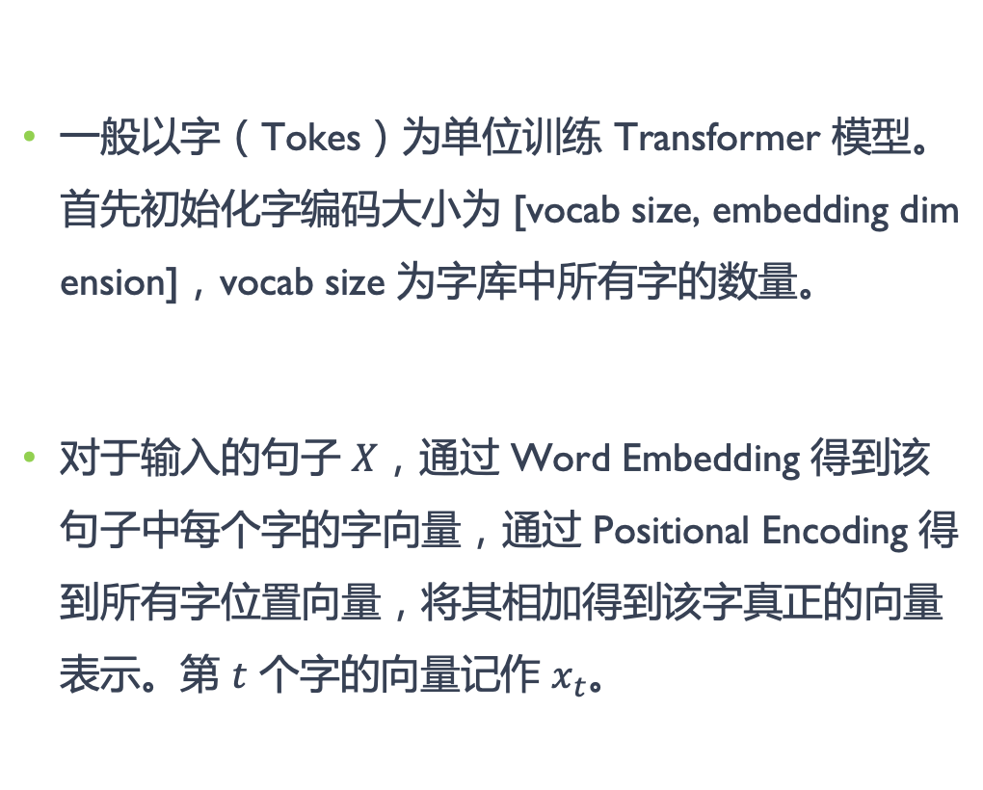
GPT – Generative Pretrained Transformer
一般以字（Tokes）为单位训练 Transformer 模型。首先初始化字编码大小为 [vocab size, embedding dimension]，vocab size 为字库中所有字的数量。
对于输入的句子 $X$，通过 Word Embedding 得到该句子中每个字的字向量，通过 Positional Encoding 得到所有字位置向量，将其相加得到该字真正的向量表示。第 $t$ 个字的向量记作 $x_{t}$。

Slide 61
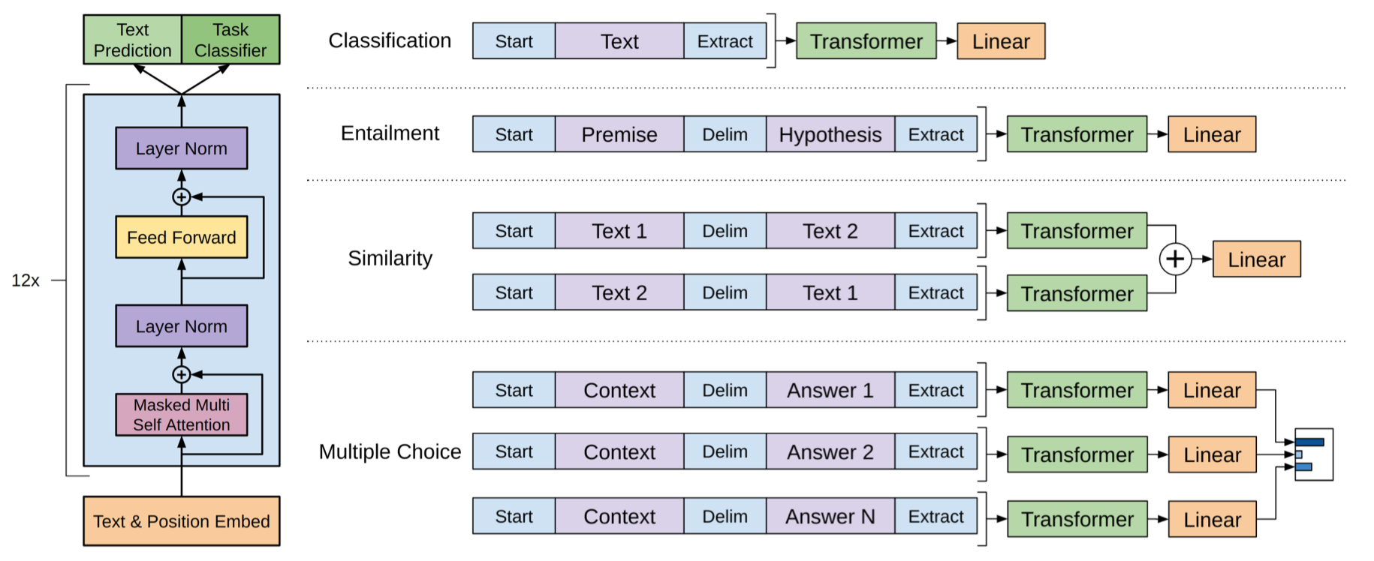
GPT – Generative Pretrained Transformer
GPT (Generative Pre-Training, Radford, 2018) is a decoder of a transformer trained for auto-regressive text generation.

Slide 62
GPT 系列

Slide 63
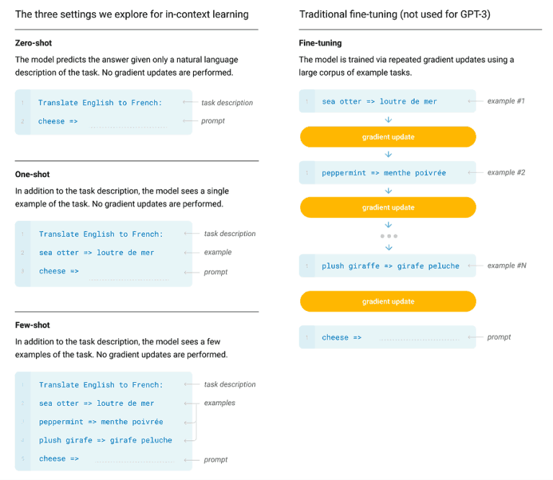
GPT – Generative Pretrained Transformer

Slide 64
小结与思考

Slide 65
选择 GPT 路线的原因
GPT是单向模型，不需要利用上下文信息，只能利用上文；而 BERT 是双向模型，训练时候需要上下文信息，更为复杂。
GPT是基于自回归模型，能够进行文本生成，可以通过 Prompt 应用在众多 NLP 任务中；BERT 采用基于自编码模型，先预训练再微调两个阶段学习文本表示，只能完成 NLP 特定任务。

Slide 66
对 Transformer 模型结构能力的思考
Transformer 能够对文本进行表示，那么图像是怎么表示的？视频又是怎么表示的？
Transformer 结构对语言能力表现上线在哪里？到底是千亿堆叠还是万亿堆叠？
Transformer 结构对图像、视频能力表现的上线在哪里？

